Slide 1


Green Pace
Security Policy Presentation
Developer: Joseph Dengler
https://youtu.be/r1R7pjJBipw

Slide 2

OVERVIEW: DEFENSE IN DEPTH
Covers technical vulnerabilities
Establishes coding and architectural standards
Necessary for standardizing practices as team grows
Supports defense-in-depth with multiple security layers across development lifecycle

Slide 3
THREATS MATRIX
Likely Code injection from unsanitized inputs | Priority Unencrypted sensitive data in transit
Low priority Missing comments or documentation for certain functions | Unlikely Obsolete code libraries without known vulnerabilities

Slide 4
10 PRINCIPLES
1. Validate Input Data
2. Heed Compiler Warnings
3. Architect and Design for Security Policies
4. Keep it Simple
5. Default Deny
6. Adhere to the Principle of Least Privilege
7. Sanitize Data Sent to Other Systems
8. Practice Defense in Depth
9. Use Effective Quality Assurance Techniques
10. Adopt a Secure Coding Standard

Slide 5
CODING STANDARDS
STD-001-CPP STD-002-INT STD-003-STR STD-004-SQL STD-005-MEM | STD-006-ASR STD-007-EXC STD-008-RSC STD-009-VAL STD-010-ERR

Slide 6



ENCRYPTION POLICIES
Encryption in Flight: Encrypts data while it is being transmitted across networks.
Encryption at Rest: Secures data stored on hard drives or databases.
Encryption in Use: Protects data currently being processed or actively used by applications.

Slide 7

TRIPLE-A POLICIES
Authentication: Verifies identity via MFA (passwords, tokens, biometrics)
Authorization: Uses Role-Based Access Control (RBAC)
Accounting: Logs and monitors user actions for auditing and compliance

Slide 8

Unit Testing
Purpose of Unit Testing Ensure that individual components of the code function as expected and detect potential vulnerabilities early.
Unit Testing Frameworks Use of frameworks like JUnit, PyTest, or NUnit to automate testing and verify code against edge cases and expected inputs.
Vulnerability Focus Focus on key vulnerabilities like buffer overflows, integer overflows, and input validation errors.

Slide 9
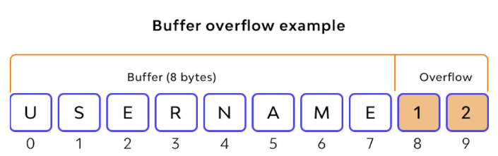
Test 1: Buffer Overflow
Buffer Overflow Prevention
Validate that the input is correctly checked to prevent buffer overflows.
Positive Test: Input within allowed limits returns valid results.
Negative Test: Input exceeding buffer limits triggers an error or prevents overflow.
Framework Application: Integration with JUnit to test boundary conditions.

Slide 10
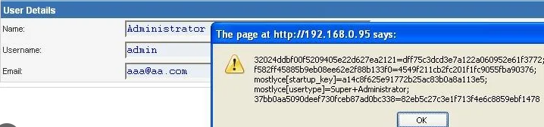
Test 2: Input Validation
Input Validation Handling
Ensure all inputs are sanitized before processing.
Positive Test: Correct input format is accepted.
Negative Test: Malicious input is rejected with proper error messages.
Framework Application: Use PyTest for testing edge cases in input validation.

Slide 11

Test 3: Integer Overflow
Integer Overflow Detection
Detect and prevent integer overflows.
Positive Test: Inputs within the valid range behave as expected.
Negative Test: Inputs exceeding the limit are rejected with appropriate safeguards.
Framework Application: Use NUnit to automate the detection of integer overflow vulnerabilities.

Slide 12

AUTOMATION SUMMARY

Slide 13

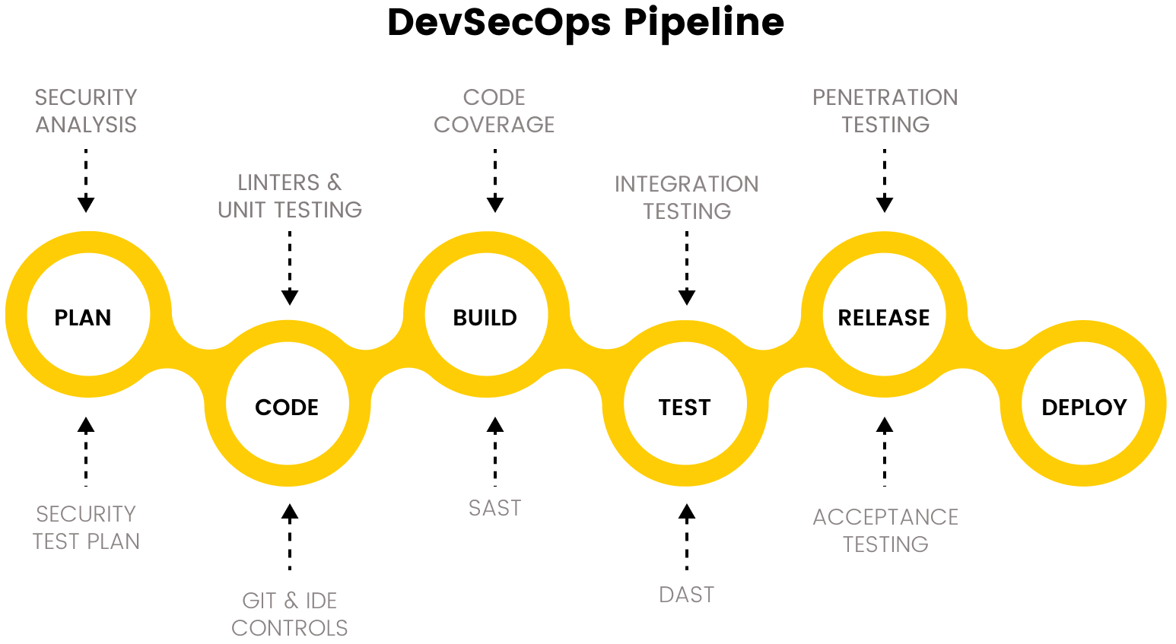
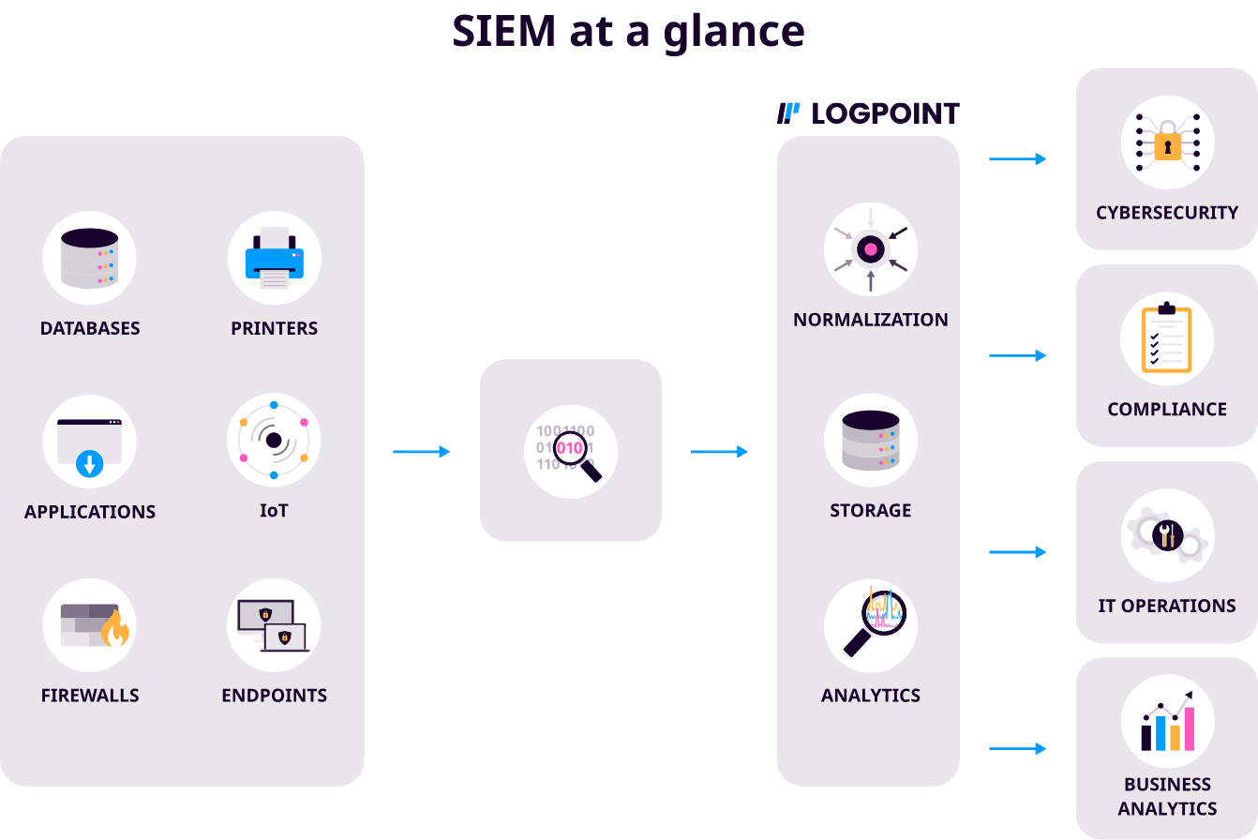
TOOLS

Slide 14
RISKS AND BENEFITS
Immediate Action:
Benefits: Stronger security posture, reduced vulnerabilities, better compliance.
Risks: Potential disruption to current systems, increased upfront costs.
Delayed Action:
Benefits: Time to refine strategy, potential cost savings in the short term.
Risks: Increased exposure to attacks, missed opportunities for mitigation.
Areas for Improvement: Evaluate continuous monitoring and automation tools.
Next Steps: Identify the highest-priority vulnerabilities and address them promptly.

Slide 15

RECOMMENDATIONS
Insufficient Incident Response Plan
Lack of Employee Training
Minimal Third-Party Risk Management
No Regular Penetration Testing

Slide 16

CONCLUSIONS
Adopt a Comprehensive Incident Response Standard
Regular Employee Security Training
Enhanced Third-Party Risk Management
Scheduled Penetration Testing

Slide 17
REFERENCES
Microsoft. (n.d.). What is DevSecOps? Definition and best practices. Microsoft Security. https://www.microsoft.com/en-us/security/business/security-101/what-is-devsecops#:~:text=DevSecOps%20is%20an%20enhancement%20to,code%20integration%20but%20also%20security
Peerbits. (2022). Complete DevSecOps guide: Key differences, tools, and best practices. Peerbits. https://www.peerbits.com/blog/devsecops-complete-guide.html
Adobe Stock. (n.d.). Adobe Stock. https://stock.adobe.com

